Slide 1

Project ODIN
Ocular Divergence reINtegration

Slide 2
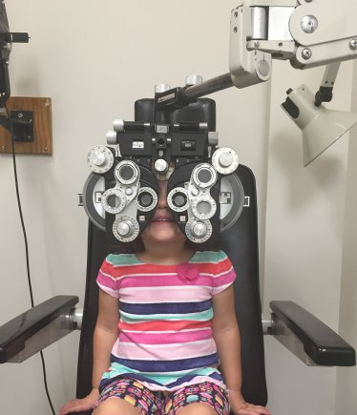
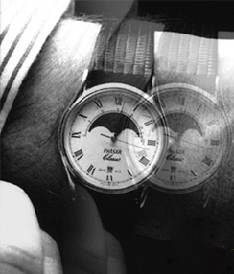
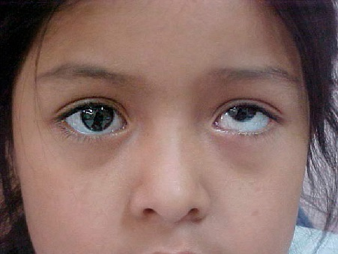
The Problem
Ocular Divergence affects about 4% of Americans
Medical terminology:
Strabismus: Abnormal alignment of the eyes
There are many forms of this condition (from mild to severe):
Amblyopia (Lazy Eye)
Diplopia (Double Vision)
Oculomotor Palsy (Unsteady Gaze)
Oculomotor Paralysis (Fixed Gaze)
Other conditions (physical abnormalities, nerve damage, muscle damage)
Some forms of this disorder are incurable today
Best treatment is early detection and therapy

Slide 3
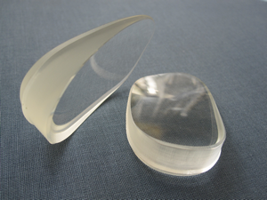
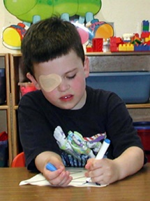
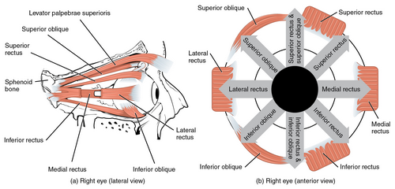
Today’s Solutions
Prism Glasses
Specialty glasses that translate and rotate the field of view via lenses
Pros: Simple user experience
Cons: Expensive to create, hard to calibrate, heavy, small effect
Physical Therapy
Exercises to train the “lazy” eye
Pros: Underlying condition is addressed
Cons: Less effective after age 7, not all disorders are treatable
Surgery
Modifications to oculomotor muscles
Pros: Permanently addresses underlying condition
Cons: Mixed outcomes, high risk

Slide 4
Project ODIN
The gaze vectors of both eyes is captured
A set of correction vectors are computed, based on a pre-trained visual model (more on this later)
The correction vectors are applied to the Field Of View (FOV)
Each eye is presented with the corrected FOV
Binocular integration is now possible!
Normal Vision
Divergent Gaze Vectors
Corrected Gaze Vectors

Slide 5
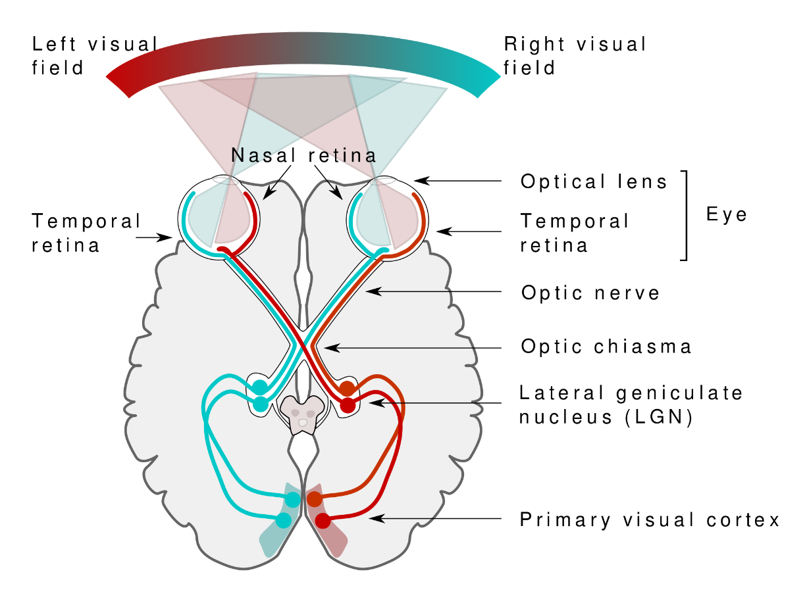
Vision is the OG Convolutional Neural Network
CNN
Our neurons are arranged in a relatively fixed set of structures, which is our wetware version of RESNET-50...
Training
Early in life, there is a window called the “critical period” where most of the training of vision occurs
Inference
Once our brain has learned to see, we use our muscles and our extremely complex CNNs to render our physical vision into mental imagery
Fusion
The complex interplay of many visual systems allows us to perceive the world as a single image—a process called stereopsis

Slide 6
The Technical Toolkit
A VR headset provides each eye with an independent Field of View
Gaze Tracking follows where each eye is currently pointing
Given a scene and one gaze vector, a CNN can be trained to predict where the second gaze vector should be looking
GPUs render the scene where each eye is gazing
A correction vector can be calculated to match the predicted gaze scene to the actual gaze vector

Slide 7
Project ODIN Pipeline

Slide 8
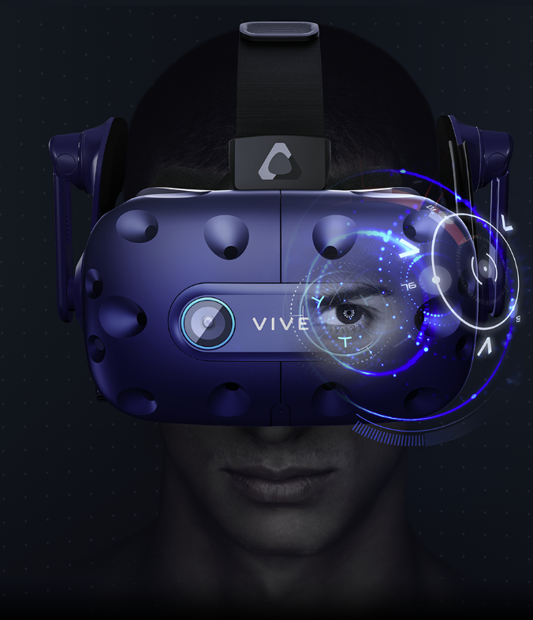
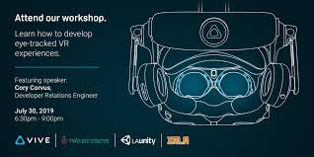
State of the Art
The Front end already exists...

Slide 9
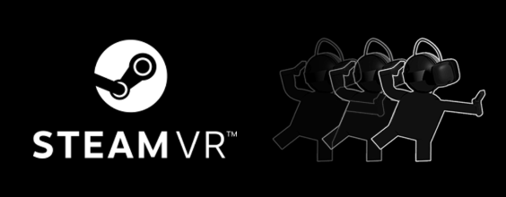
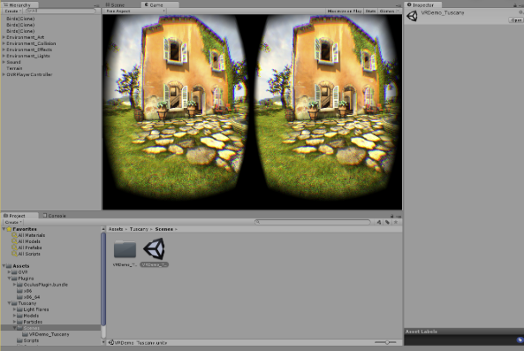
State of the Art
The back end mostly exists...

Slide 10
Deep Learning and Gaze Prediction
The missing piece is gaze prediction
This is a Deep Learning problem with a twist
Data sets for normal eyes are easy to generate
Follow a dot with your gaze, this will map vectors to targets
Data sets are noisy
People don’t always track, cicades cause small motions in the 10s to 100s of ms
Actual inference will be based on individual disability
Framing of this problem is really difficult!

Slide 11
Description of PSU Capstone
Migrate ODIN to new hardware
Vive Pro Eye
Migrate ODIN SW to new SW stack
SteamVR
Tasks
Identify API to acquire gaze vectors
Identify API to change FOV
Create an eye model to map gaze vectors to FOV changes
Constant (FOV changes invariant to gaze vectors)
Bilinear interpolation (FOV changes based on static map)
Neural network (FOV changes based on trained CNN)

